Slide 1
NODE.JS
(The Backend Of MERN Stack)
Lecture 37

Slide 2
Today’s Agenda
Fetching Data Using Mongoose
Using find()
Adding Conditions
Exercises

Slide 3
Fetching Data Using Mongoose
In Mongoose, to fetch the data from MongoDB we have three methods:
find()
findOne()
findById()

Slide 4
Using find()
The find() method belongs to Model constructor and is the primary tool for querying the database.
Syntax:
Model.find({filter},{projection},options)
filter: Represents the filter object . MongoDB will search for all documents that match the filter. If we pass an empty filter, then MongoDB will return all documents.
projection: A string or object representing fields to be returned
options: An object representing limit or skip options

Slide 5
What does find() return ?
The Model.find() method returns a Query object and it is almost same as a Promise object since it supports then() and async-await operations.
In case we want Promise object then we can call the exec() method of Query object.

Slide 6
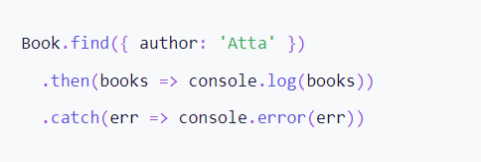
Using then() with find()

Slide 7
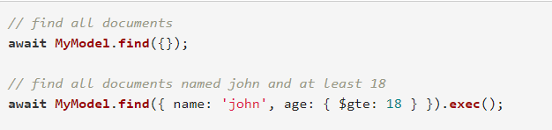
Using await with find()

Slide 8
Exercise 69
Write an Node-Mongoose application to connect to the MongoDB database and fetch and display all the records from emps collection.

Slide 9
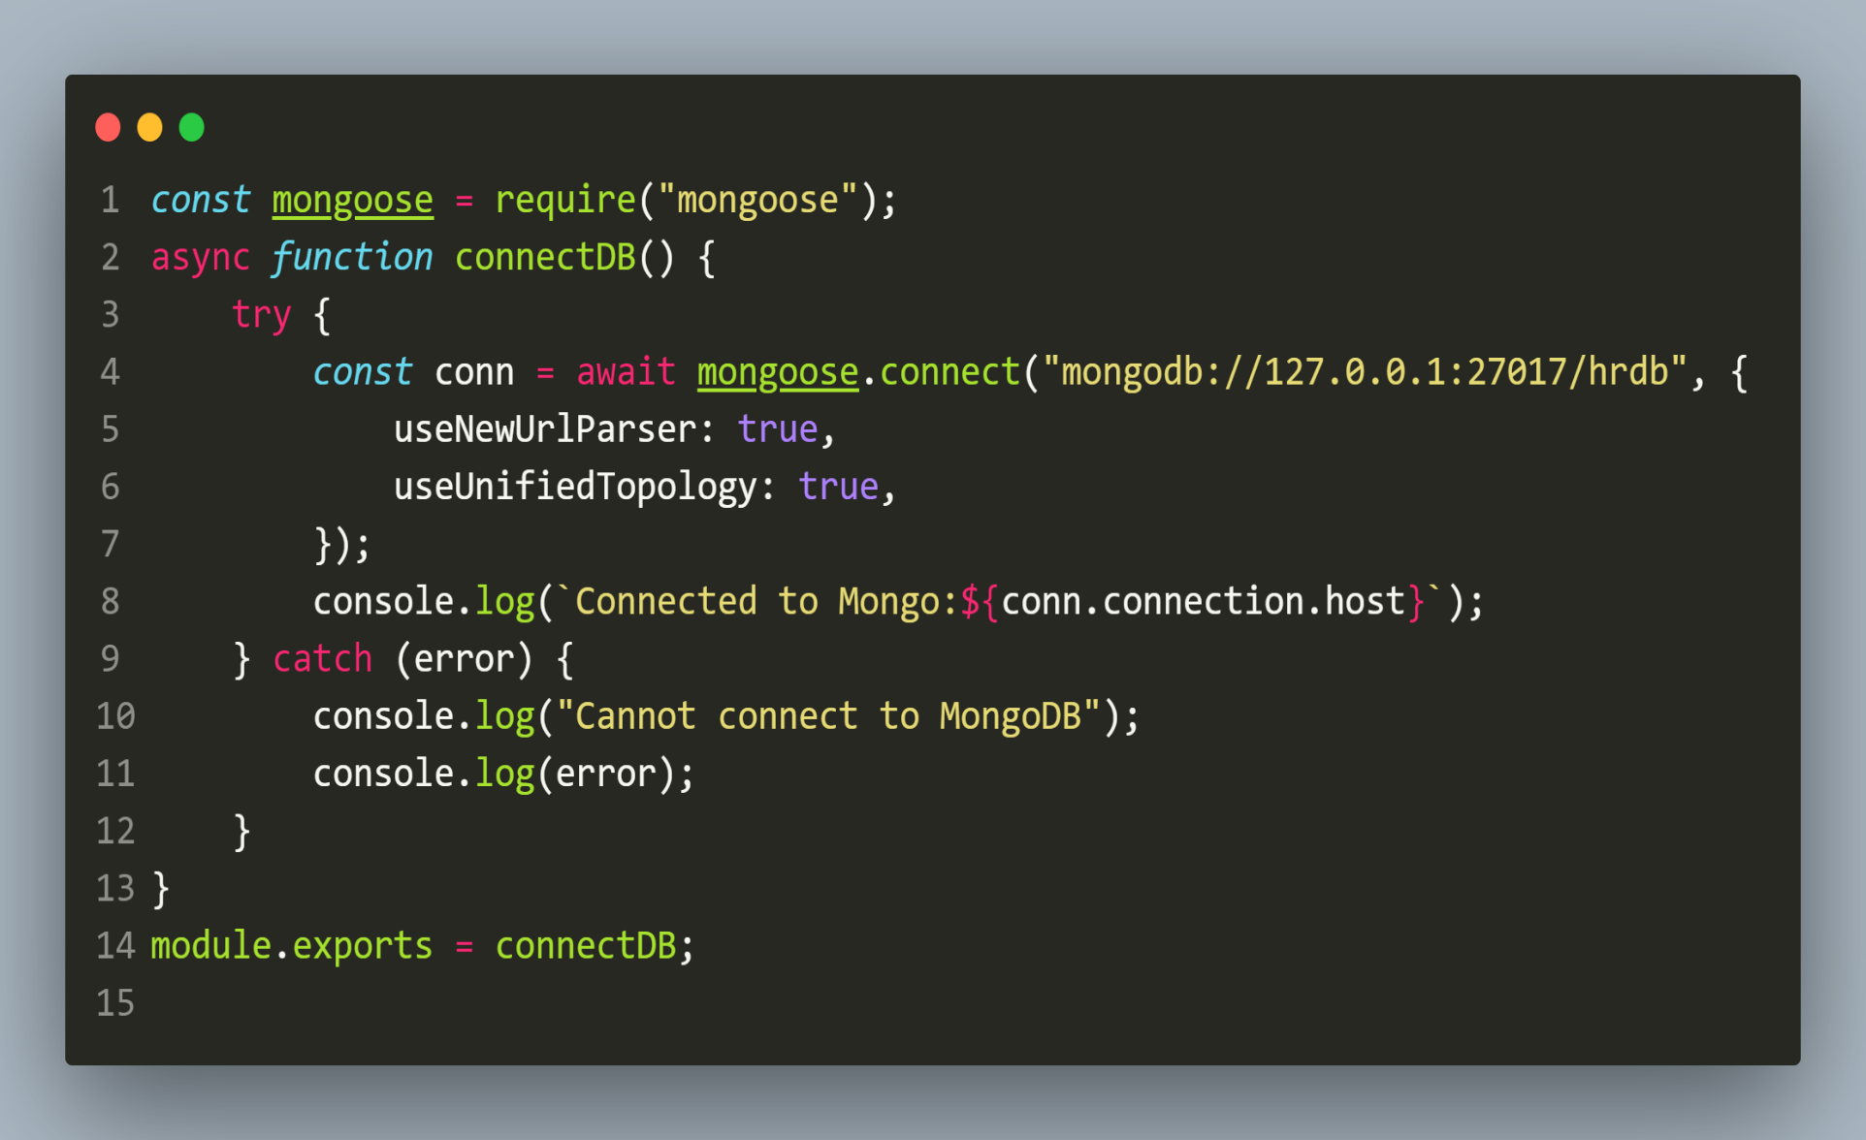
Solution(db.js)

Slide 10
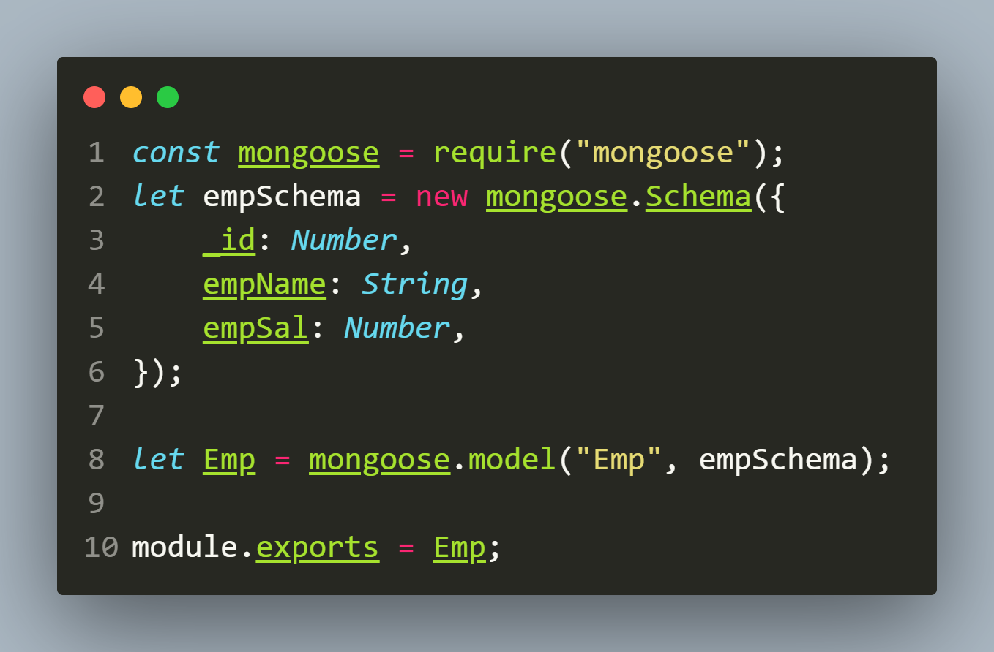
Solution(empModel.js)

Slide 11
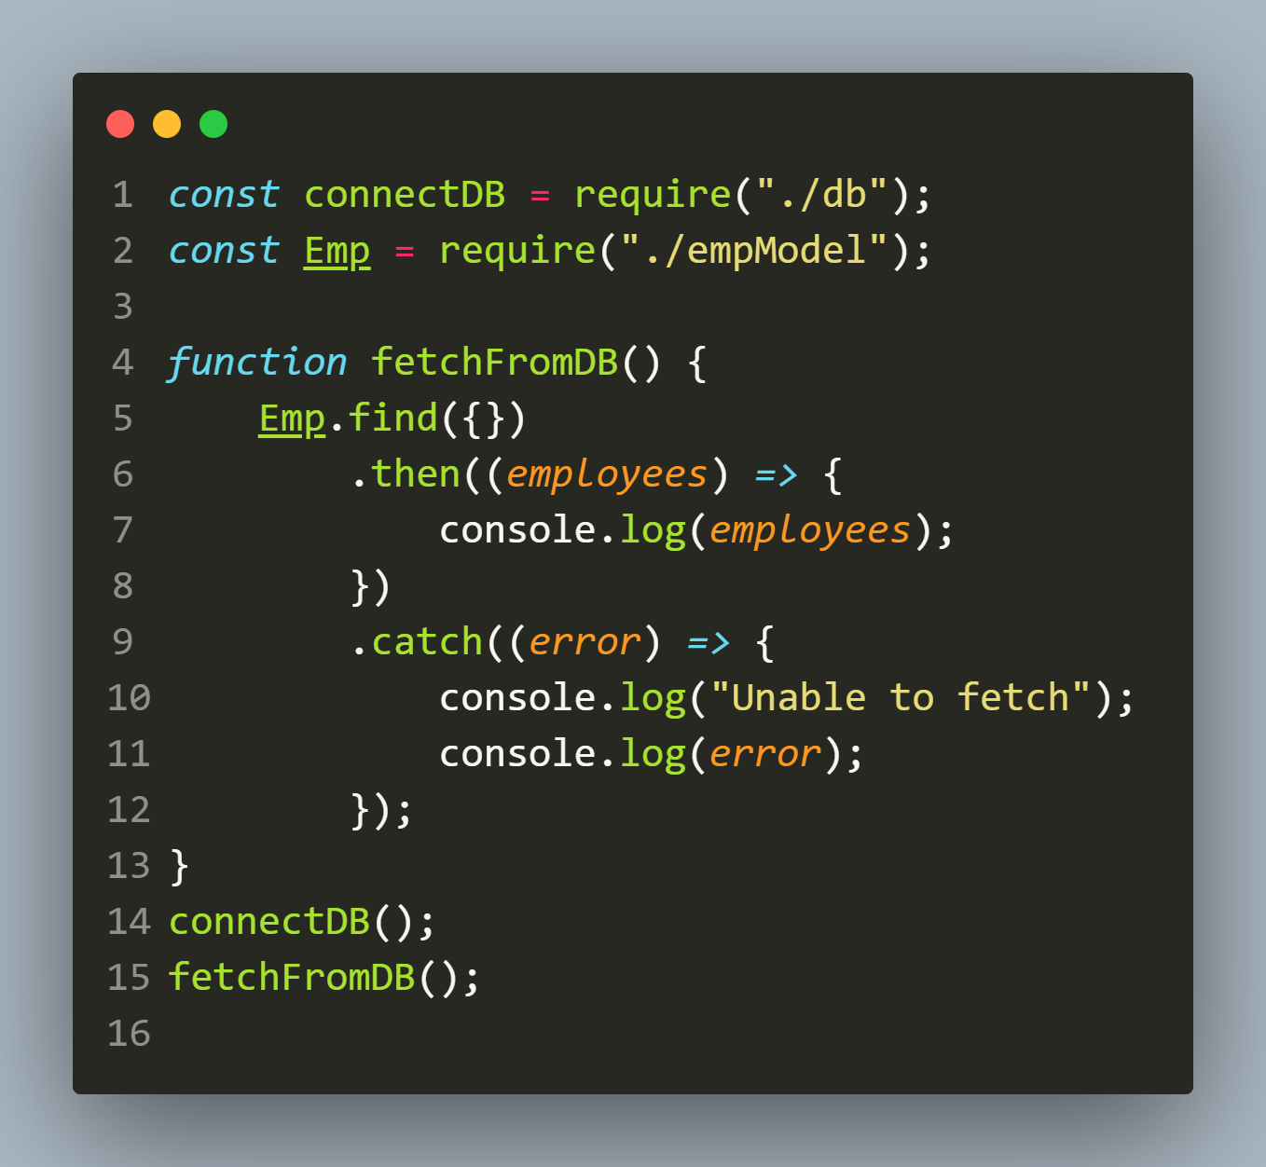
Solution-1(app.js using then)

Slide 12
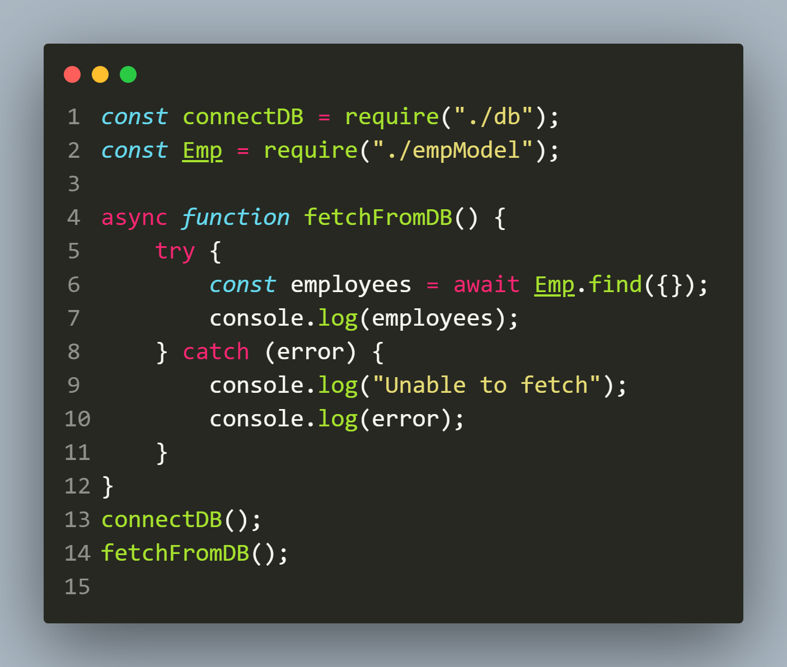
Solution-2(app.js using async-await)

Slide 13
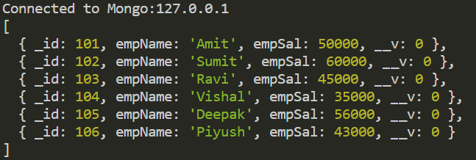
output

Slide 14
Exercise 70
Modify the previous app so that now your code displays total number of records fetched from the database as well as empName and empSal for each record individually in one row.
Make sure not to include _id field.

Slide 15
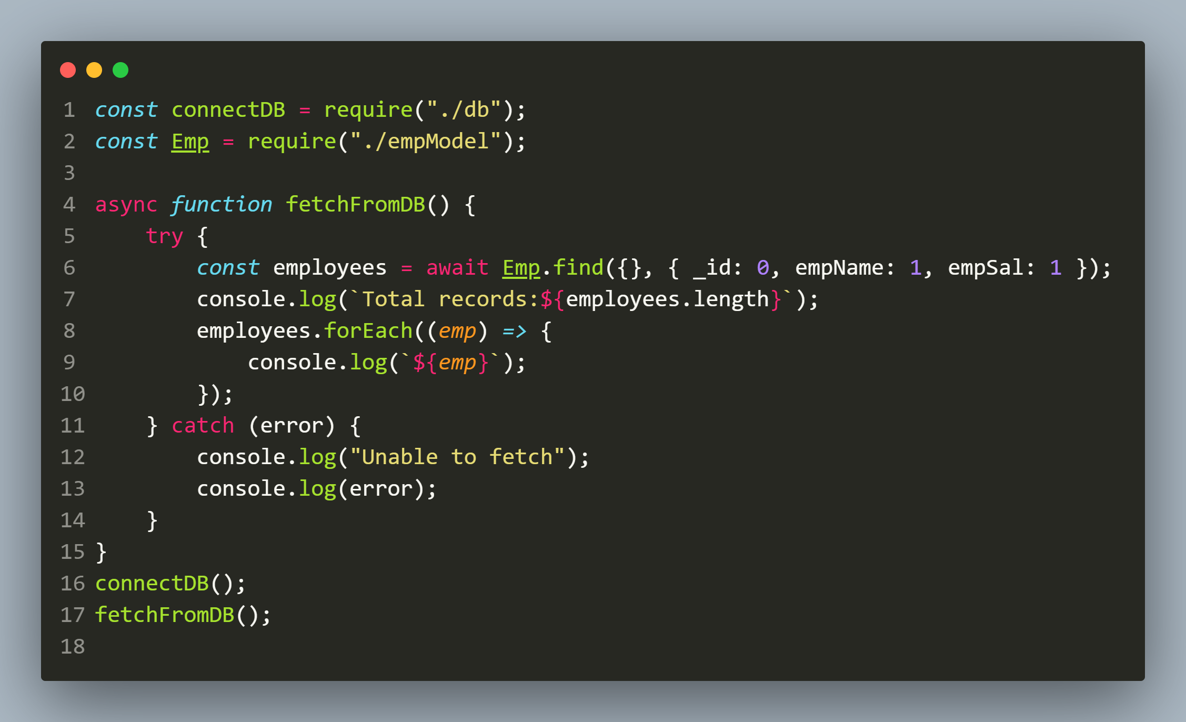
solution

Slide 16
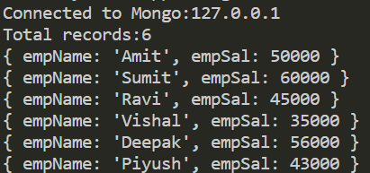
output

Slide 17
Exercise 71
Write an Expresss-EJS-MongoDB application to handle the following api calls:
POST: /api/employees : To accept employee id, employee name and employee salary and insert a new record in the Emps collection
GET : /api/employees : To return total number of employees as well as records of all the employees as JSON objects.
GET : /api/employees/:id : To accept an id as route parameter and return the record of that employee .
In case of any exception/problem during query processing return appropriate response code with message.

Slide 18
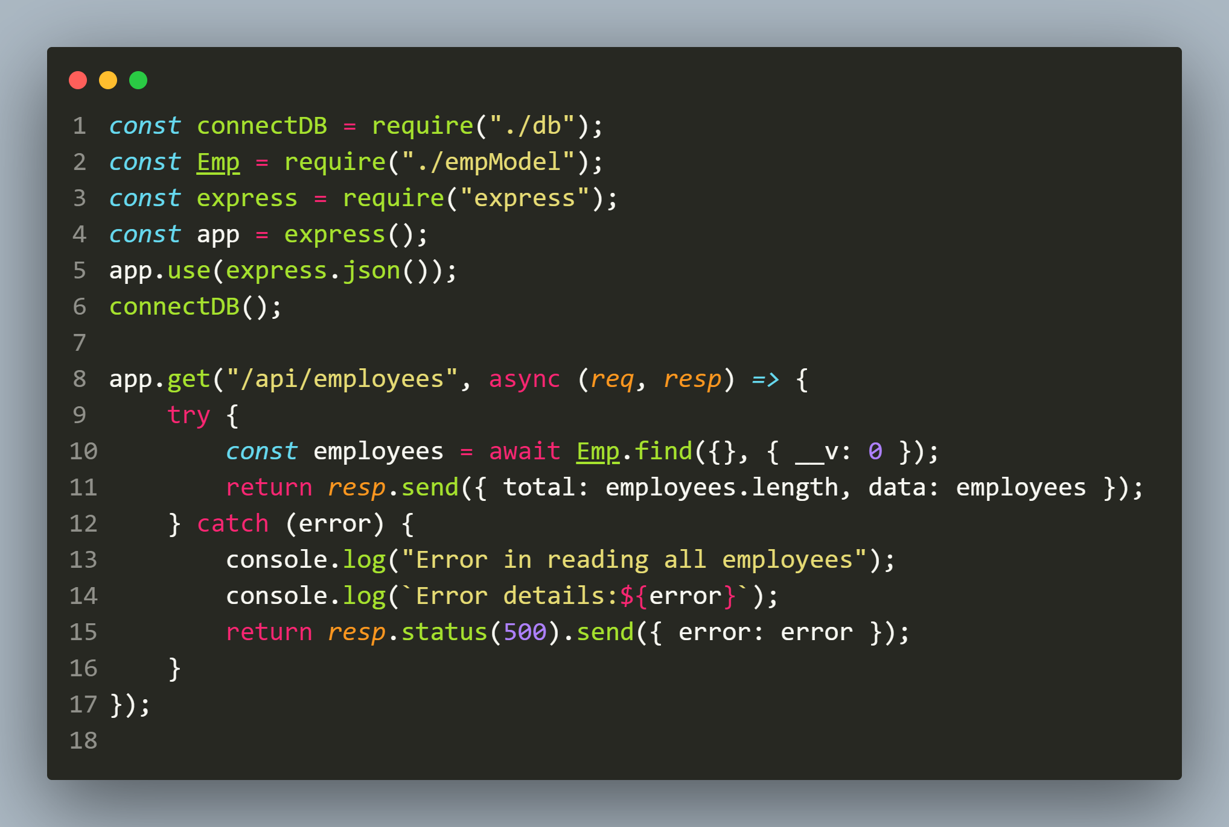
solution

Slide 19
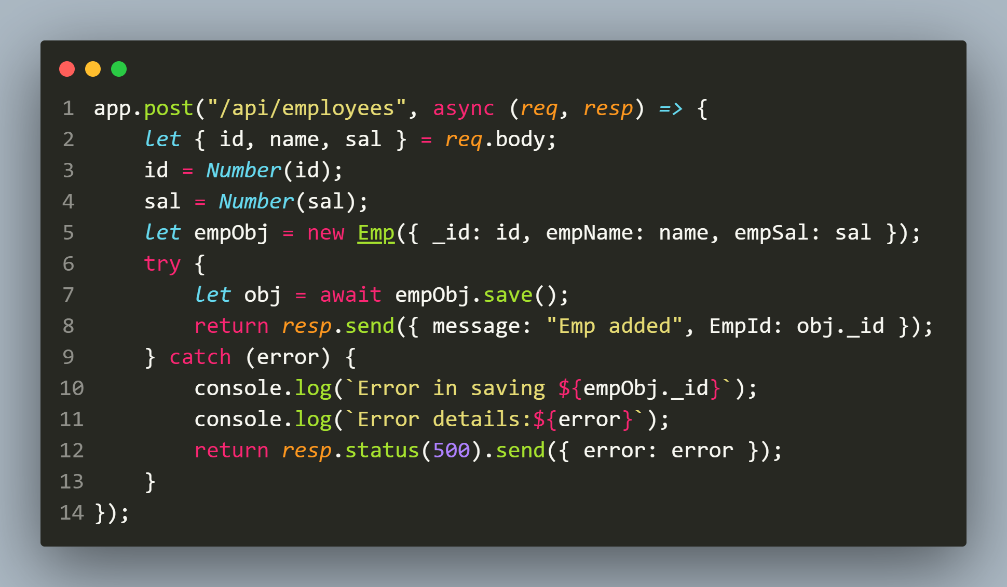
solution

Slide 20
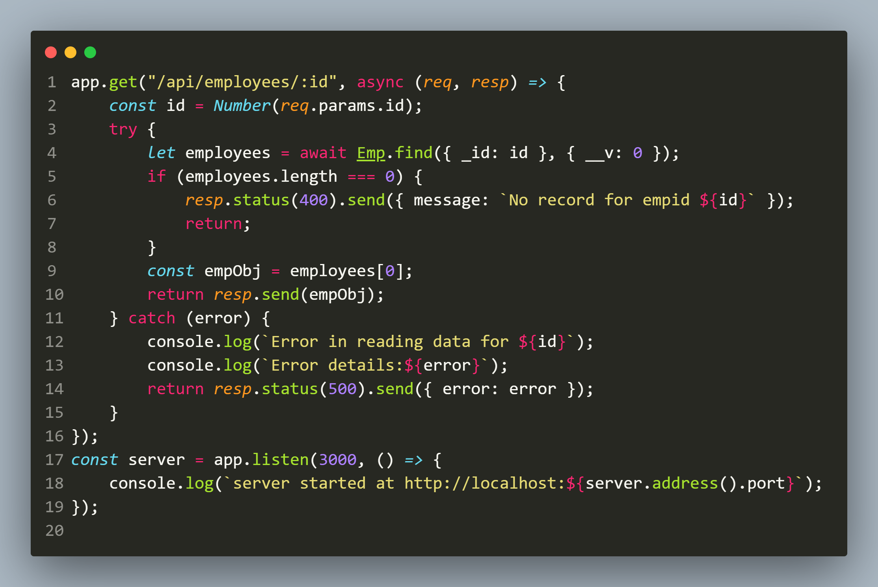
solution

Slide 21
Improvements to app.js
We can improve the previous code in app.js by moving all the repetitive DB operations to a separate module called dbOperations.
Further we can import dbOperations in app.js and call the required functions.
This will make our code more manageable and systematic.

